Slide 1
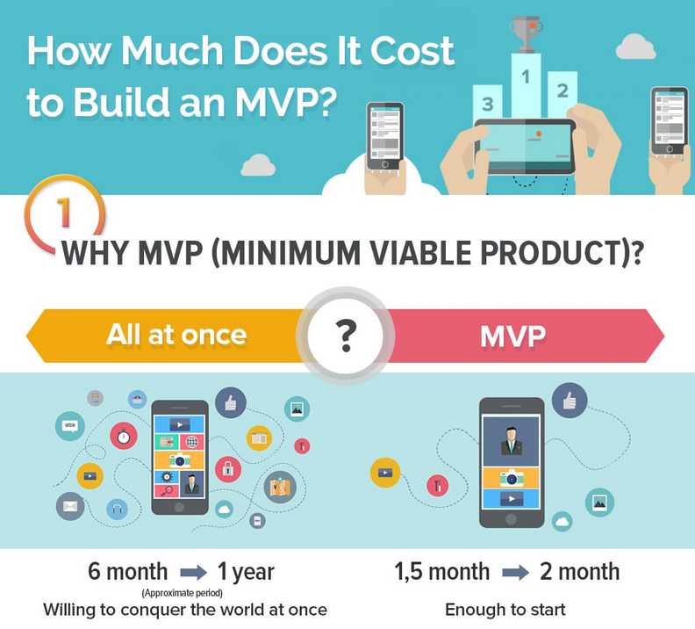

Slide 2
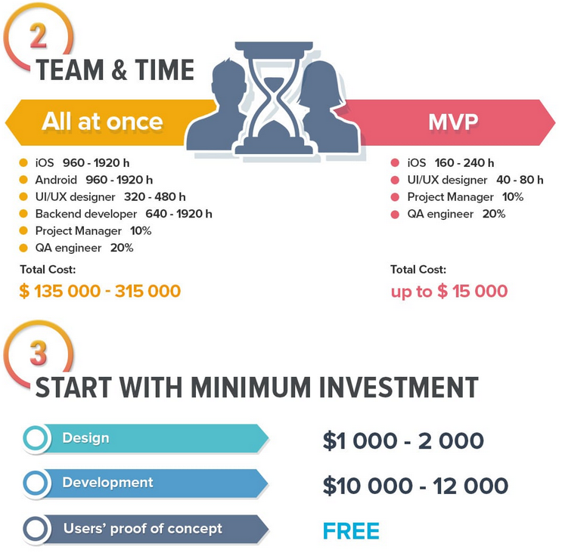

Slide 3
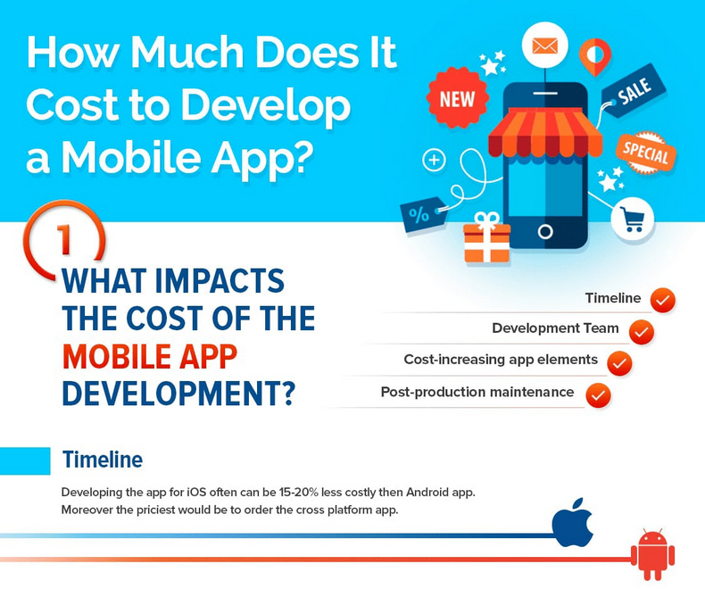

Slide 4
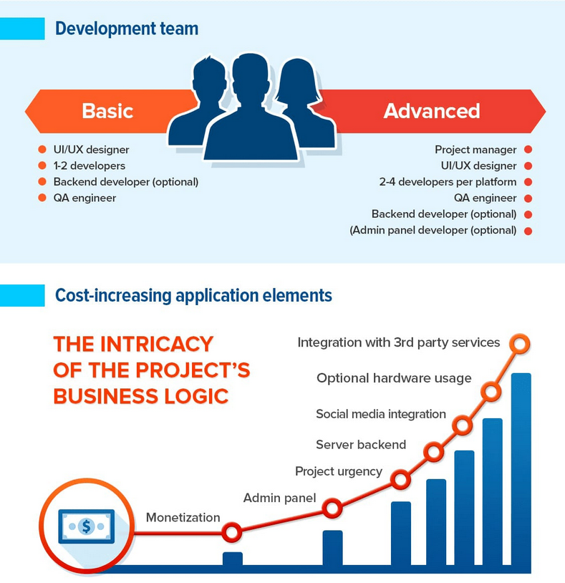

Slide 5
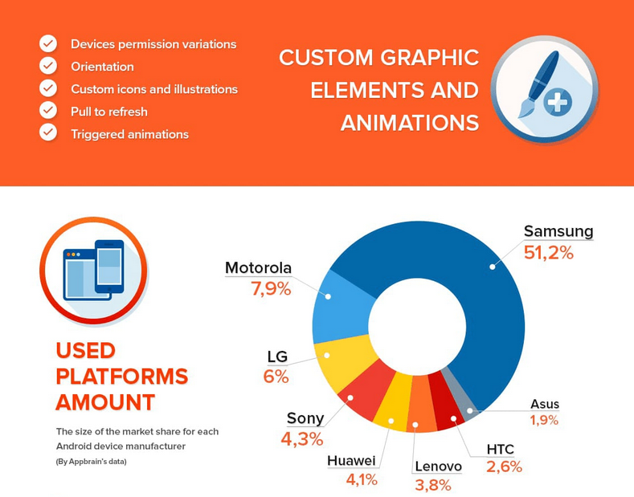

Slide 6
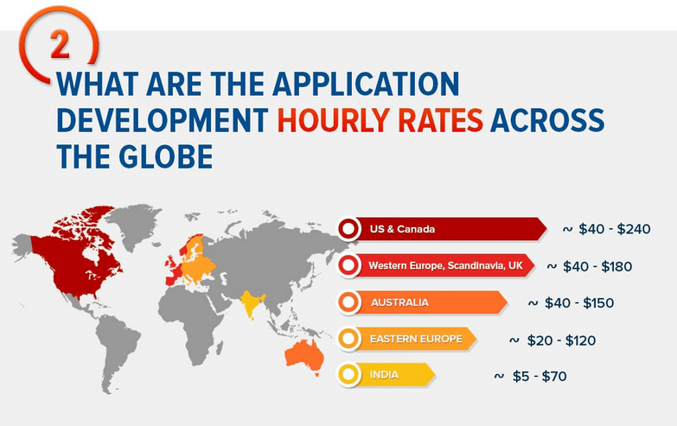

Slide 7
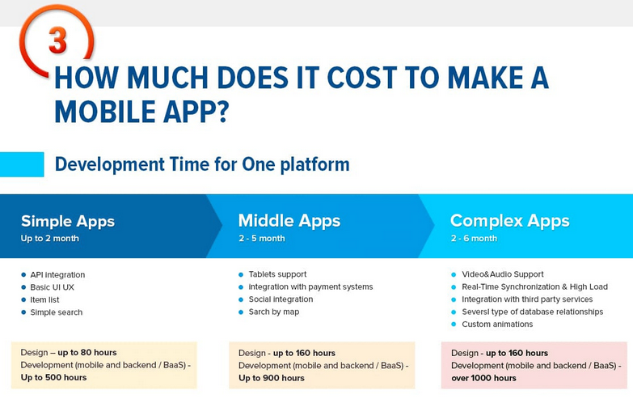

Slide 8
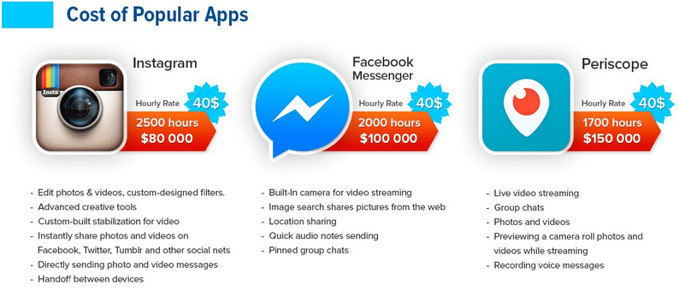

Slide 9
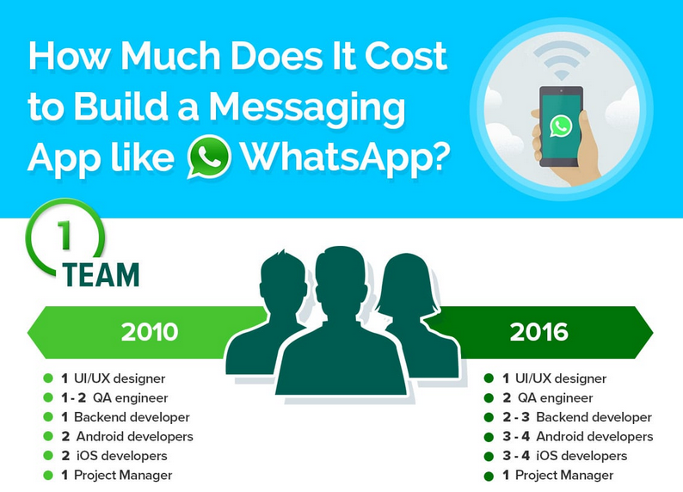
https://erminesoft.com/how-much-does-it-cost-to-develop-a-chat-app-like-whatsapp/

Slide 10
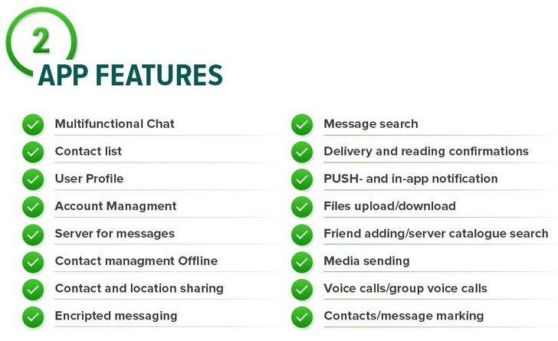

Slide 11
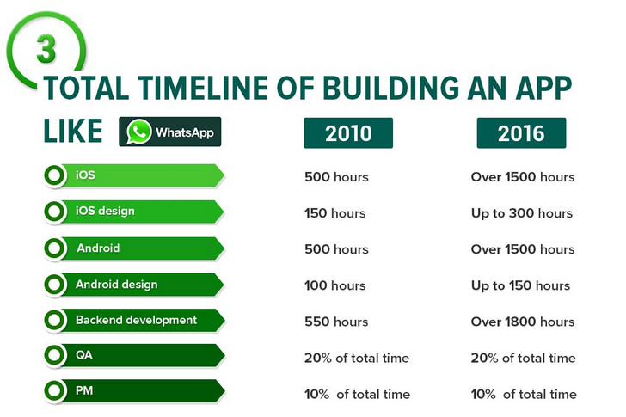

Slide 12
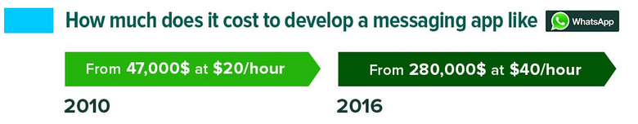
It should be noted that a big plus to messenger’s maintenance is that it requires hiring only a minimum team. For example, one of the WhatsApp’s chat app developers maintains on average about 20-21 million of active users.
Thus, after the creation of the application support costs are reduced practically to zero, all the funds can be spent on the product expansion and promotion. This will allow you to focus on app improvement and collaboration with partners.

Slide 13
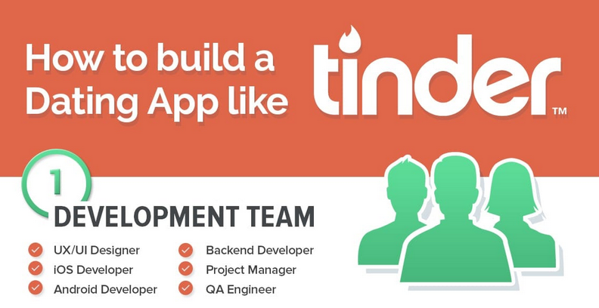
https://erminesoft.com/how-to-build-dating-app-like-tinder/

Slide 14
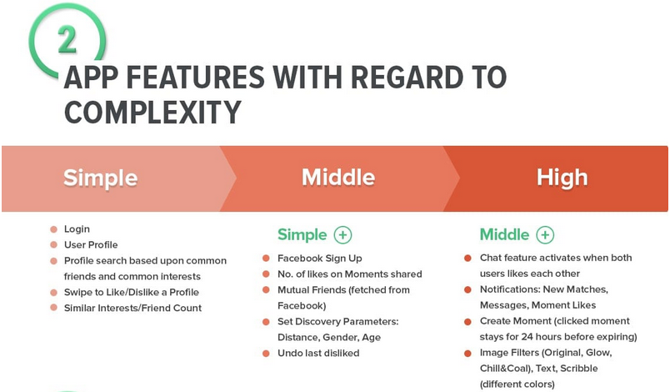

Slide 15
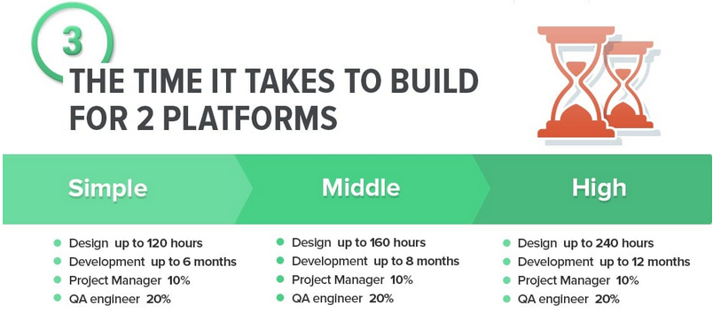

Slide 16
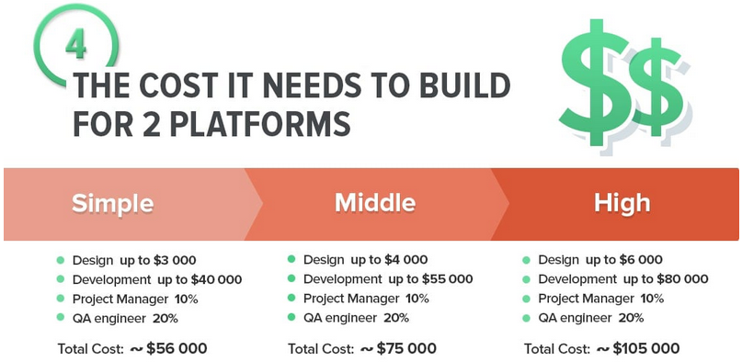

Slide 17
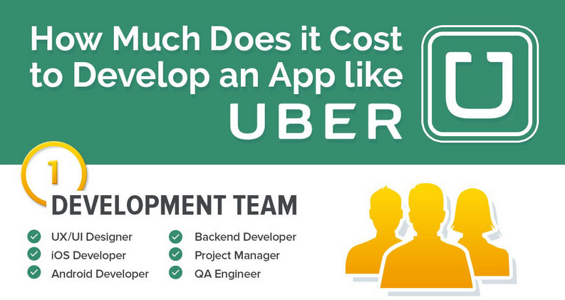

Slide 18
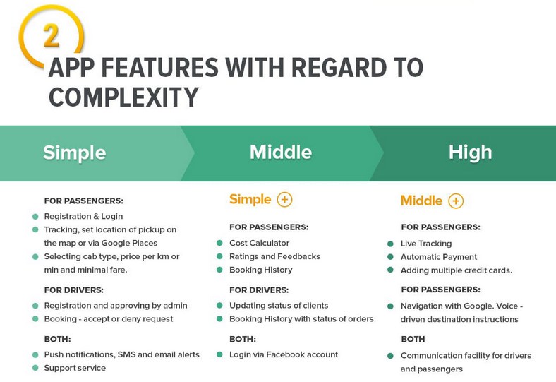

Slide 19
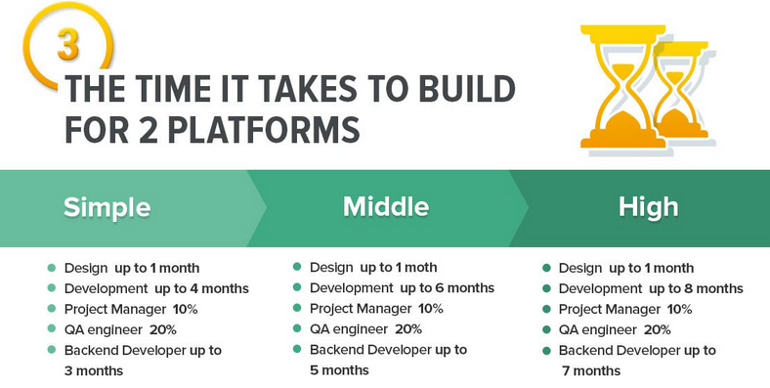

Slide 20
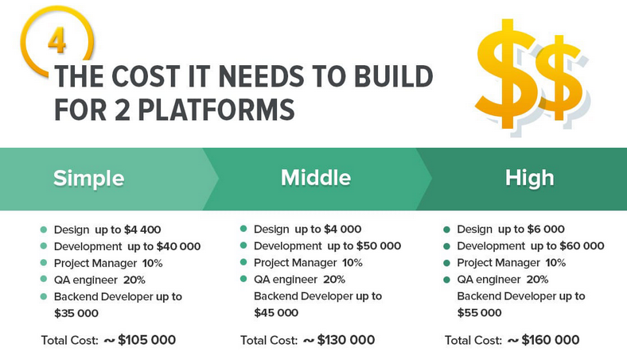

Slide 21
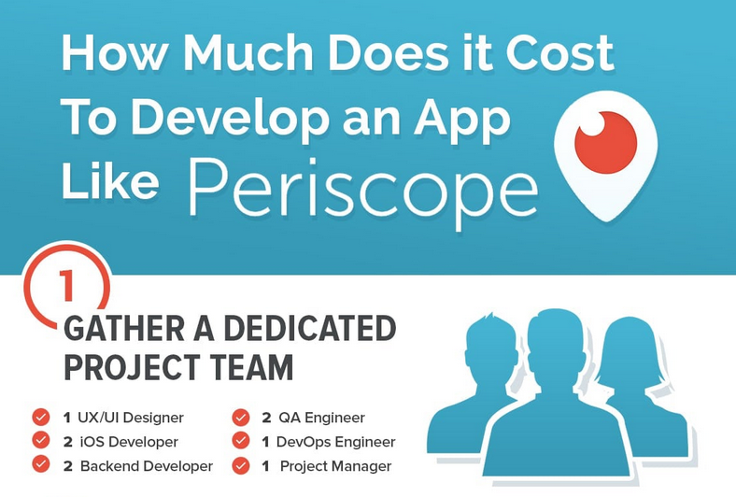

Slide 22
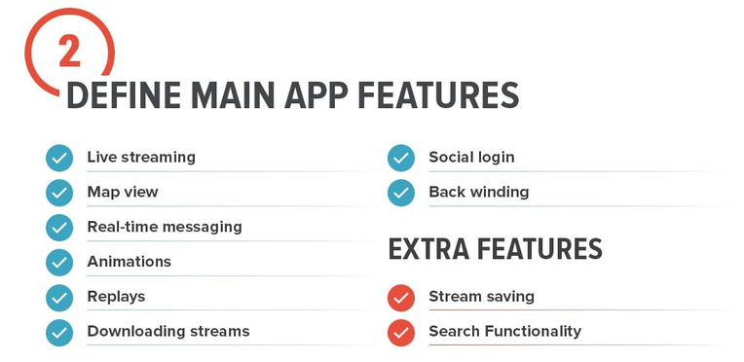

Slide 23


Slide 24
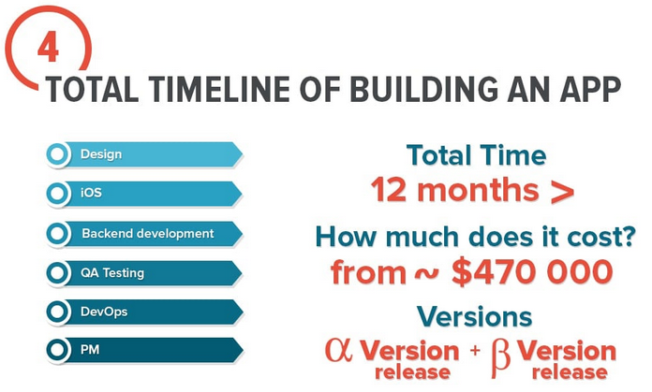

Slide 25
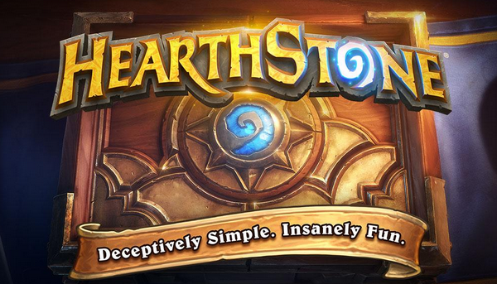
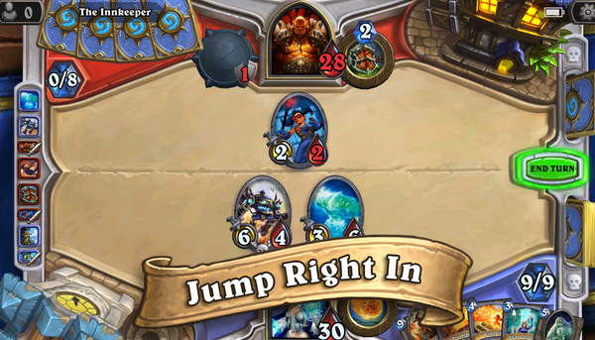

HearthStone -
free-to-play online collectible card video game
Published: 2014
Developer: Blizzard
Genre: Card Game
Costs: ?

Slide 26
HearthStone -
free-to-play online collectible card video game
Published: 2014
Developer: Blizzard
Genre: Card Game
Costs: $250,000+

Slide 27
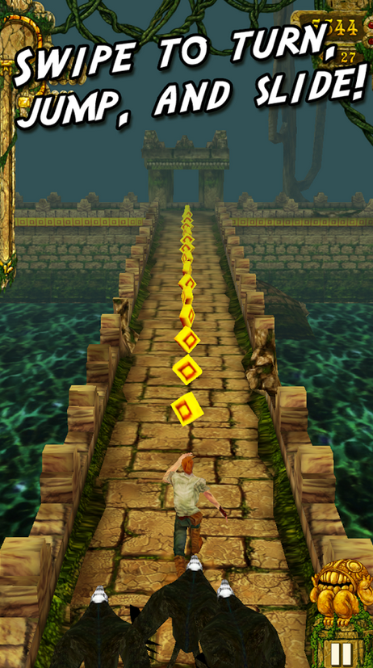
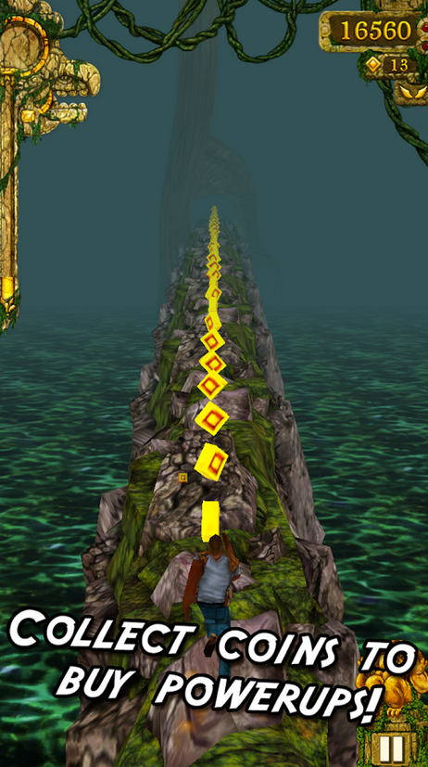
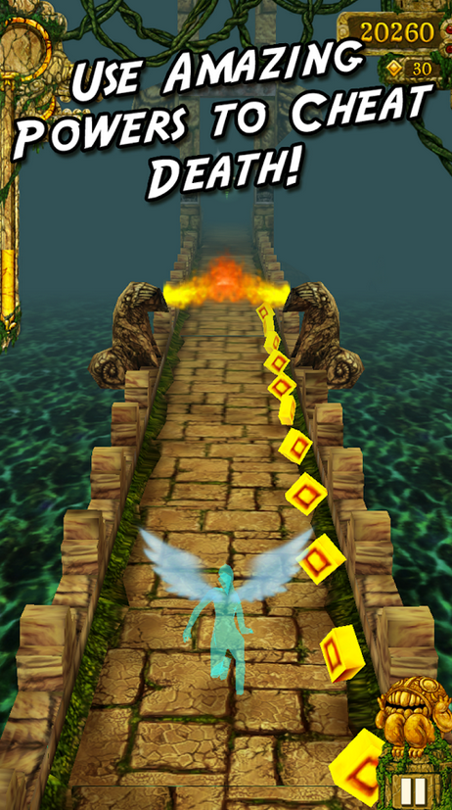
Temple Run
Published: 2011
Developer: Imangi Studios
Genre: Endless Runner
Costs: ?

Slide 28
Temple Run
Published: 2011
Developer: Imangi Studios
Genre: Endless Runner
Costs: from $10,000 to $250,000

Slide 29
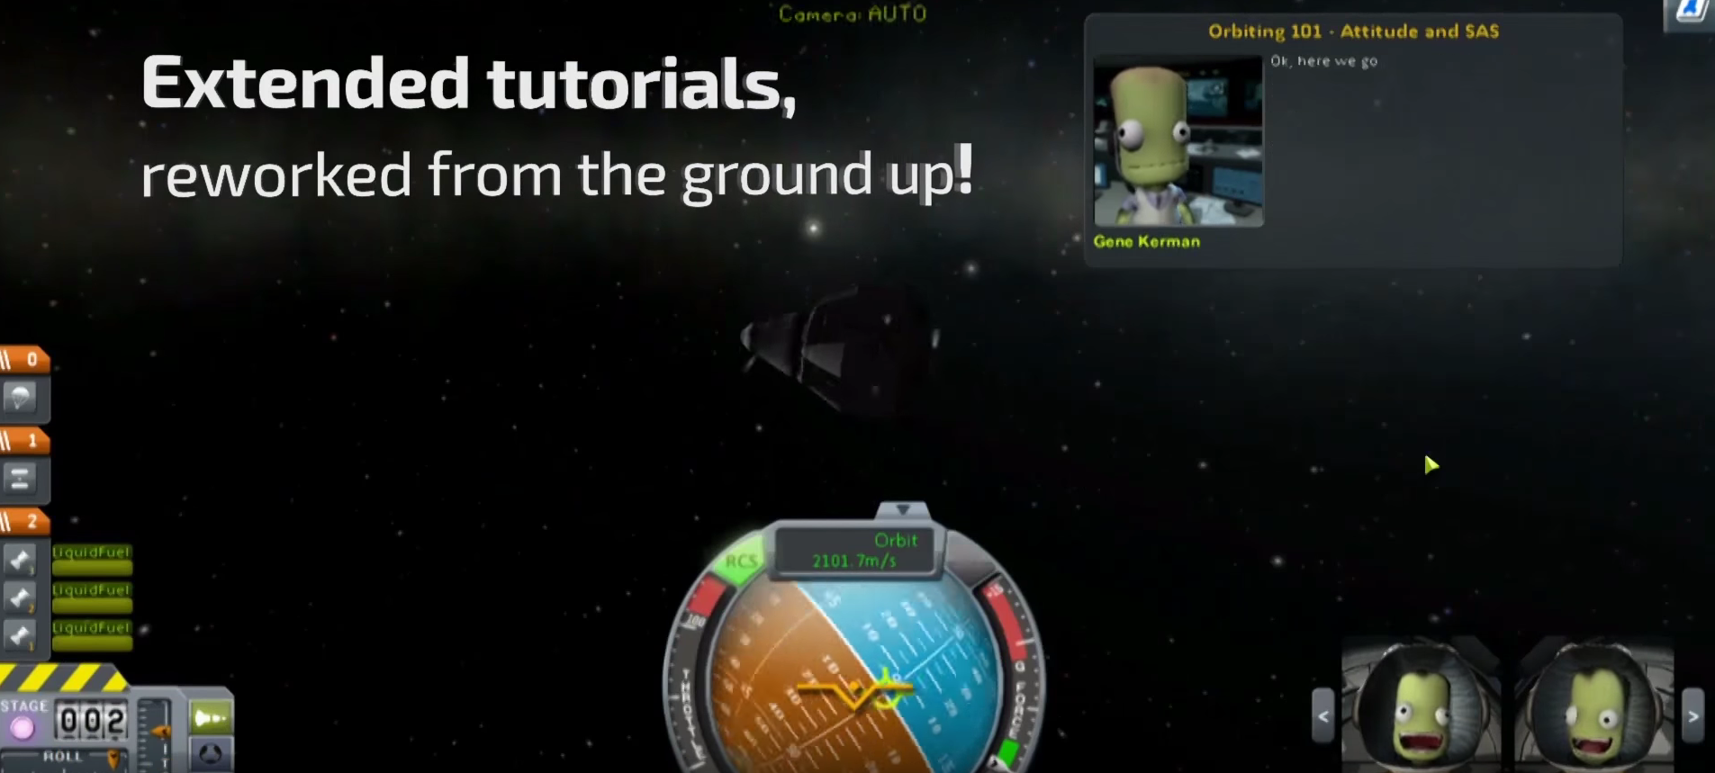
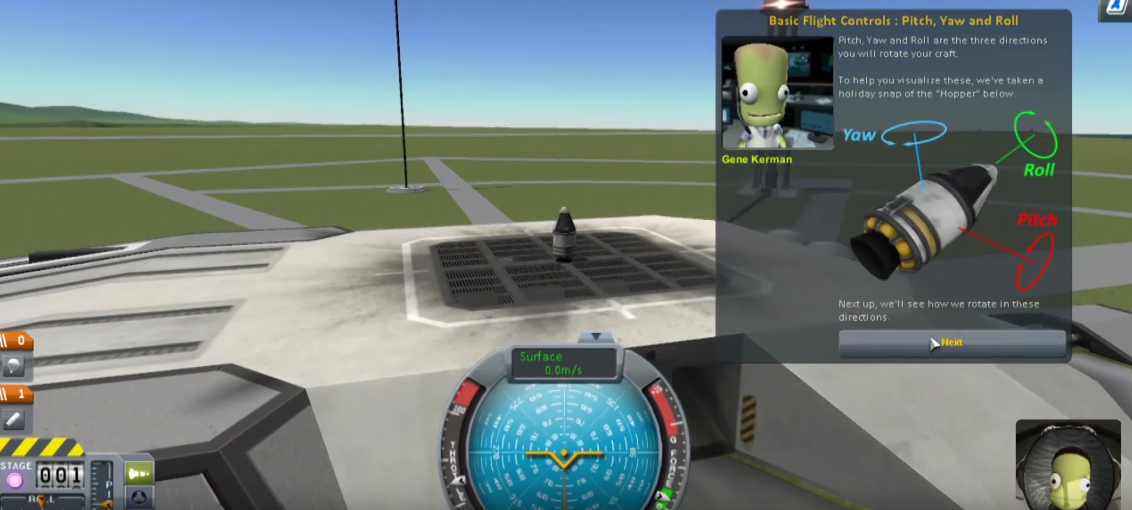
Kerbal Space Program
Published: 2011
Developer: Squad
Genre: Space flight simulator
Costs: ?

Slide 30
Kerbal Space Program
Published: 2011
Developer: Squad
Genre: Space flight simulator
Costs: $300,000+

Slide 31
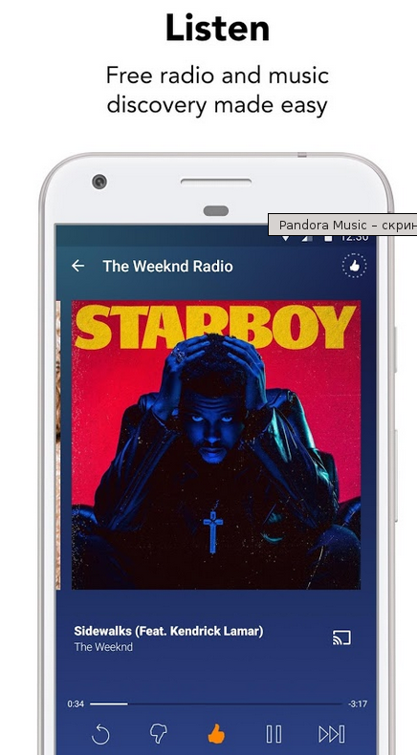
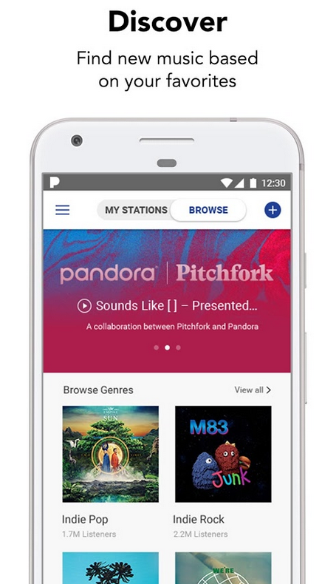
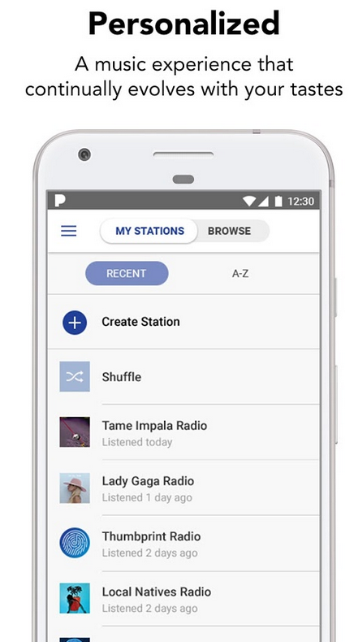
Pandora Radio
Founded in 2000 by Tim Westergren, currently, the company has an estimated capitalization at nearly $4 billion, which is not surprising – at the time, Pandora was the first to offer a revolutionary approach that allowed the user to adjust the playlist to their liking.
Costs: ?

Slide 32
Pandora Radio
Founded in 2000 by Tim Westergren, currently, the company has an estimated capitalization at nearly $4 billion, which is not surprising – at the time, Pandora was the first to offer a revolutionary approach that allowed the user to adjust the playlist to their liking.
Costs: around $60,000+

Slide 33

Evernote
Evernote is a cross-platform app designed for note taking, organizing, and archiving.
Costs: ?

Slide 34
Evernote
Evernote is a cross-platform app designed for note taking, organizing, and archiving.
Costs: ~1100 hours

Slide 35
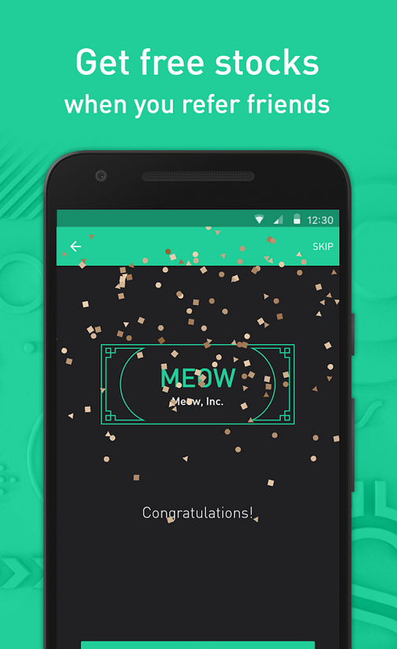
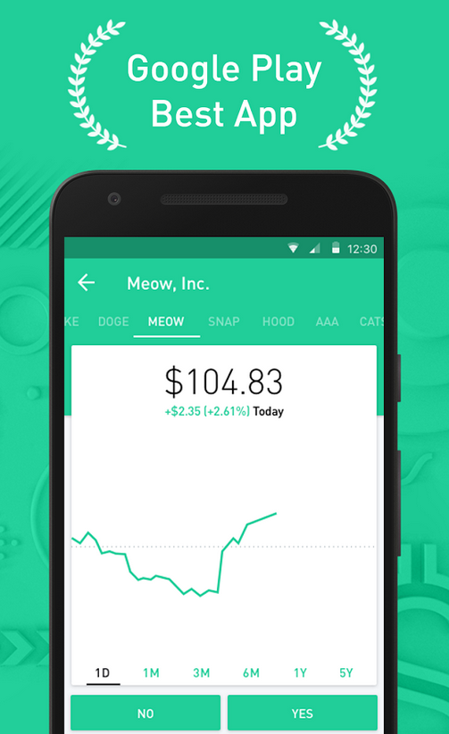
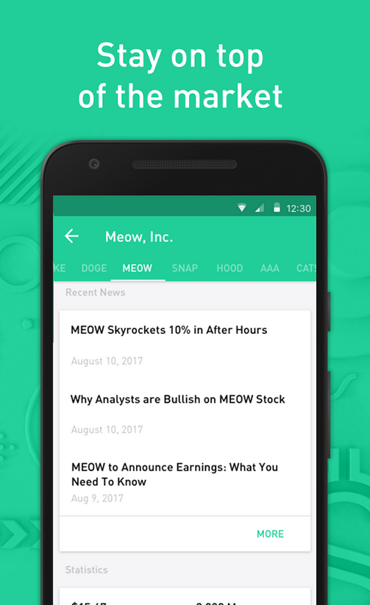
Robinhood - Free Stock Trading
Costs: ?

Slide 36
Robinhood - Free Stock Trading
Costs: not less than $25 000

Slide 37

eBay - Online Auction
Costs: ?

Slide 38
eBay - Online Auction
Costs: it will take around 1400-2000 hours

Slide 39

Pinterest
Pinterest is an online website (and already has an app version as well) which acts like a giant photo library. It allows the users to search for images, to arrange them into thematic folders, to share those folders, to subscribe to other people’s folders and, moreover, it gives the opportunity to save the images from other websites into Pinterest folders
Costs: backend, frontend, mobapp?

Slide 40
Pinterest
Pinterest is an online website (and already has an app version as well) which acts like a giant photo library. It allows the users to search for images, to arrange them into thematic folders, to share those folders, to subscribe to other people’s folders and, moreover, it gives the opportunity to save the images from other websites into Pinterest folders
Costs: 400-600 hours for the back end, 500-750 for the front end and 250-350 for the mobile development

Slide 41
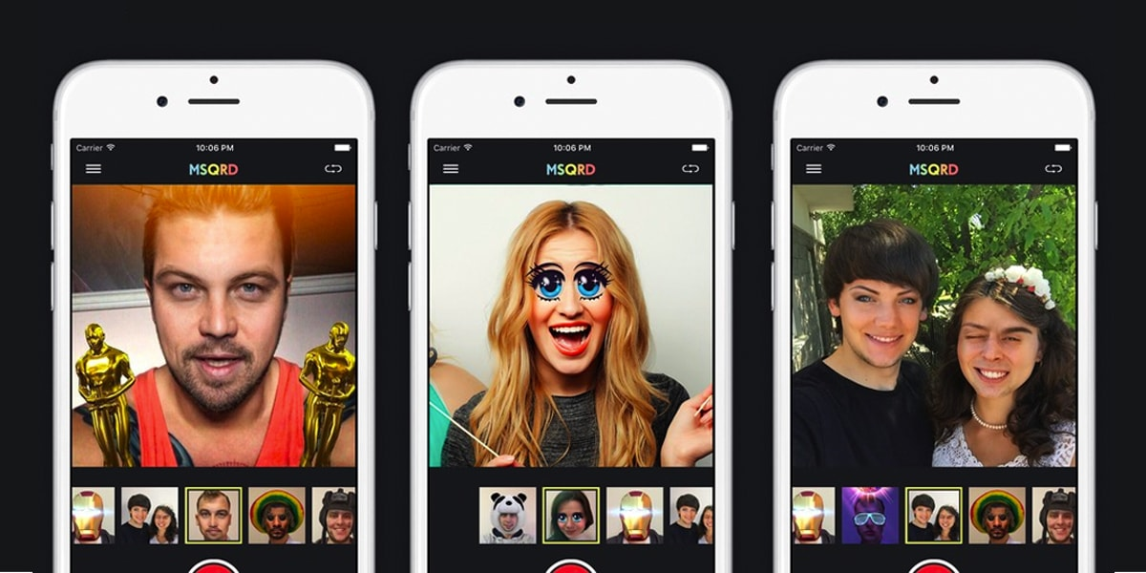
MSQRD
MSQRD has been designed with a face detection appliance (engine) – Google Cloud Vision API, powerful image analysis. In simple words you could upload pictures using the API and google’s backend will analyze them and recognize.
Costs: ?

Slide 42
MSQRD
MSQRD has been designed with a face detection appliance (engine) – Google Cloud Vision API, powerful image analysis. In simple words you could upload pictures using the API and google’s backend will analyze them and recognize.
Costs: about $ 30,000 for the Android and iOS versions

